Slide 1
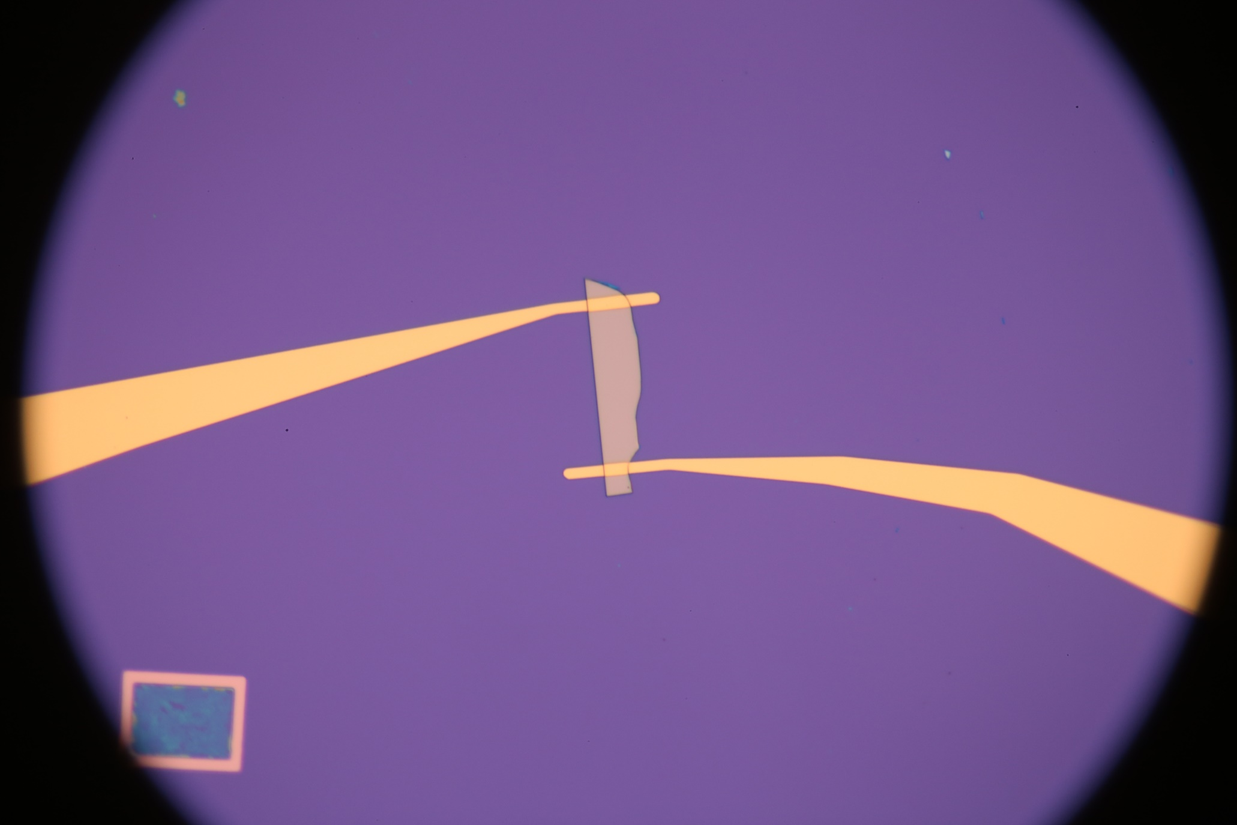
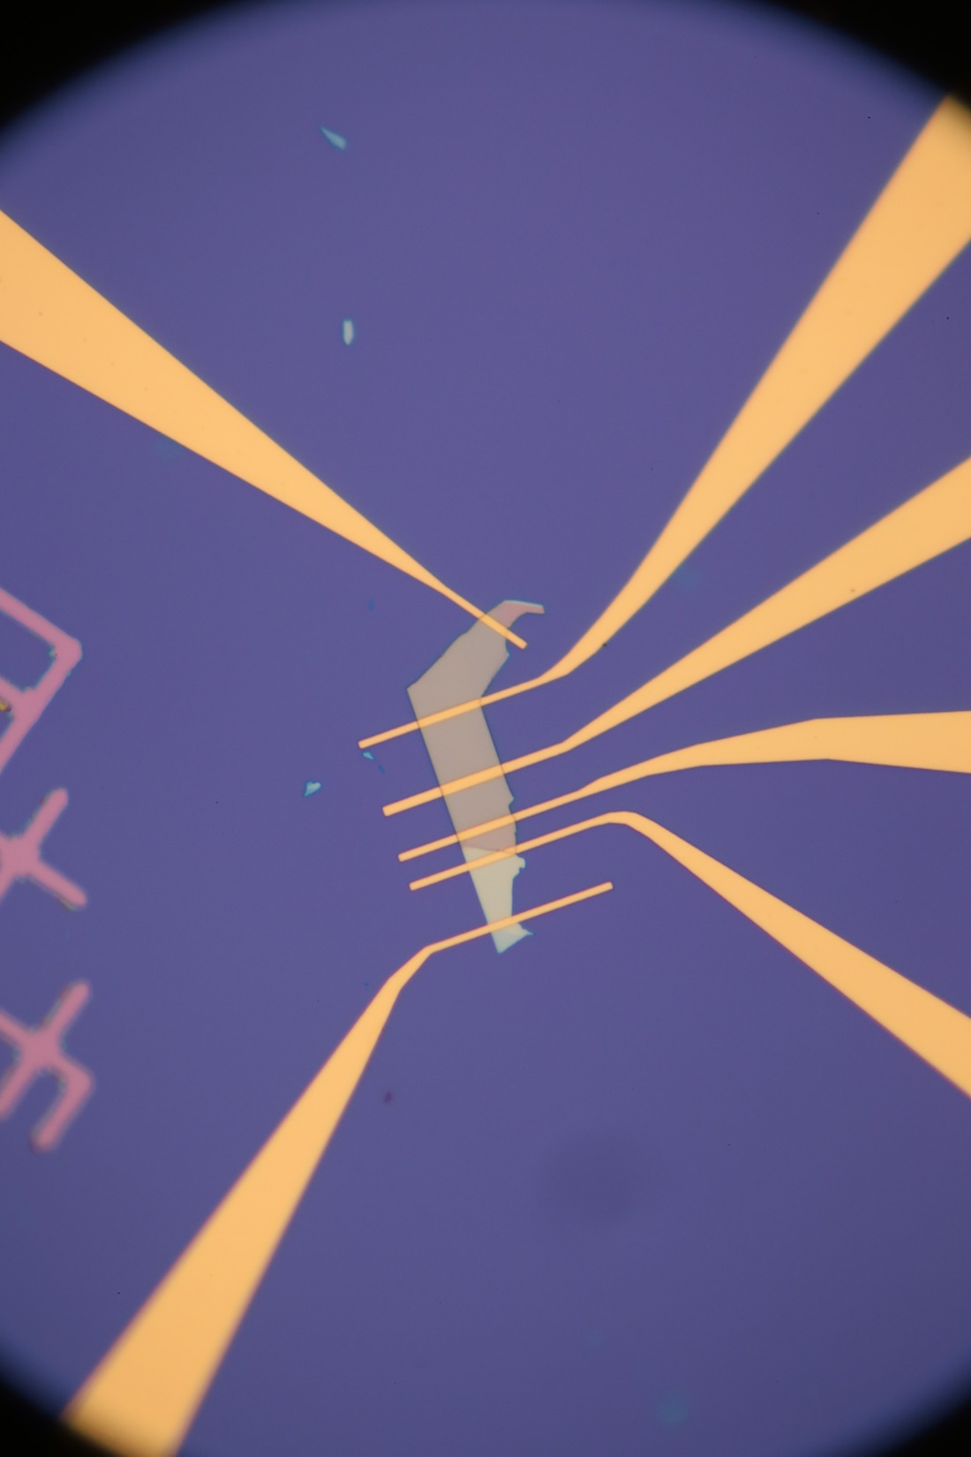
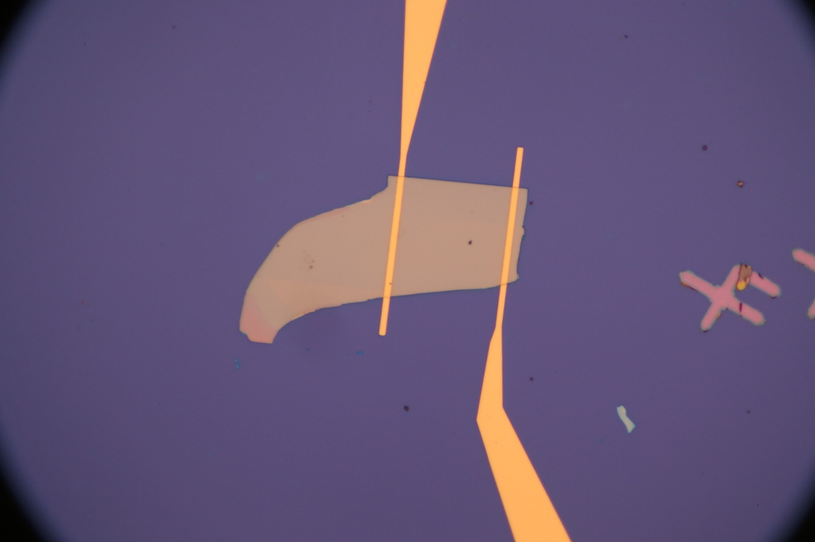
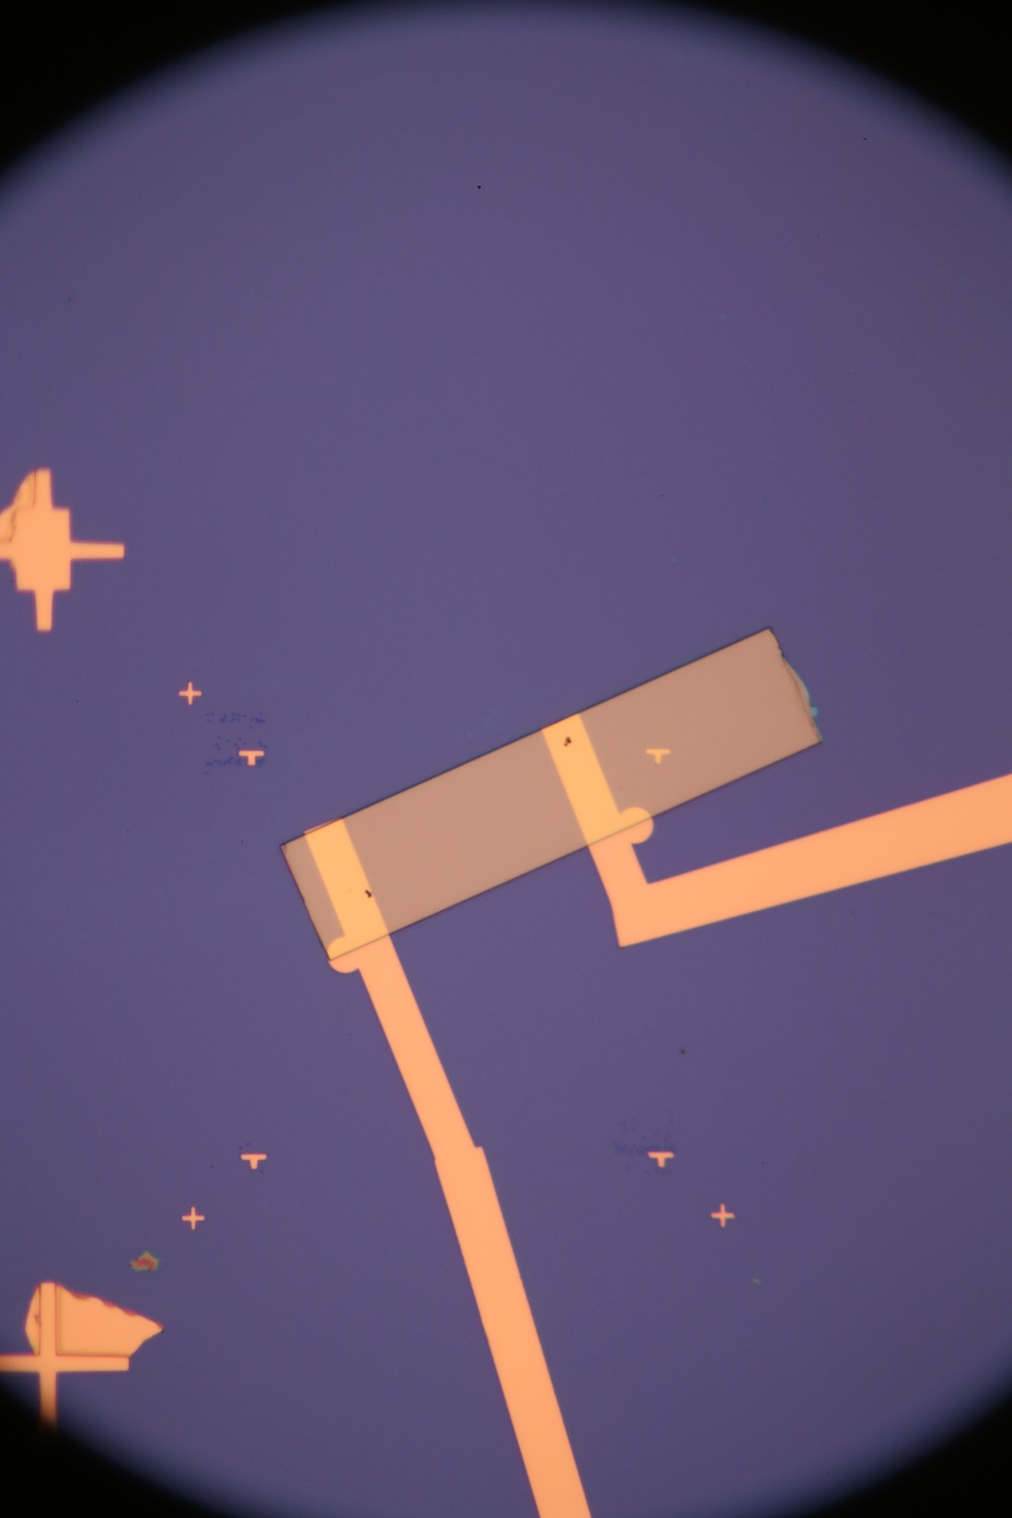
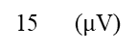
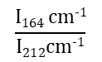
a
b
c
2
$$\frac{I164 cm−1}{I212cm−1}$$
1
0
1
2
d
e
f
-0.5
0
0.5 (nA)
-0.2
-0.1
0
0.1
0.2
0.3 (nA)
-0.3
-0.2
-0.1
0
0.1
0.2
0.3 (nA)
g
h
i
-0.2
-0.1
0
0.1
0.2 (nA)
-0.3
-0.2
-0.1
0
0.1
0.2 (nA)
j
k
l
-0.1
0
0.1
0.2 (nA)
-10
-5
0
5
10
15 ($μ$V)

Slide 3
Notes:
Edge along polarization 164>212

Slide 5
